Slide 1
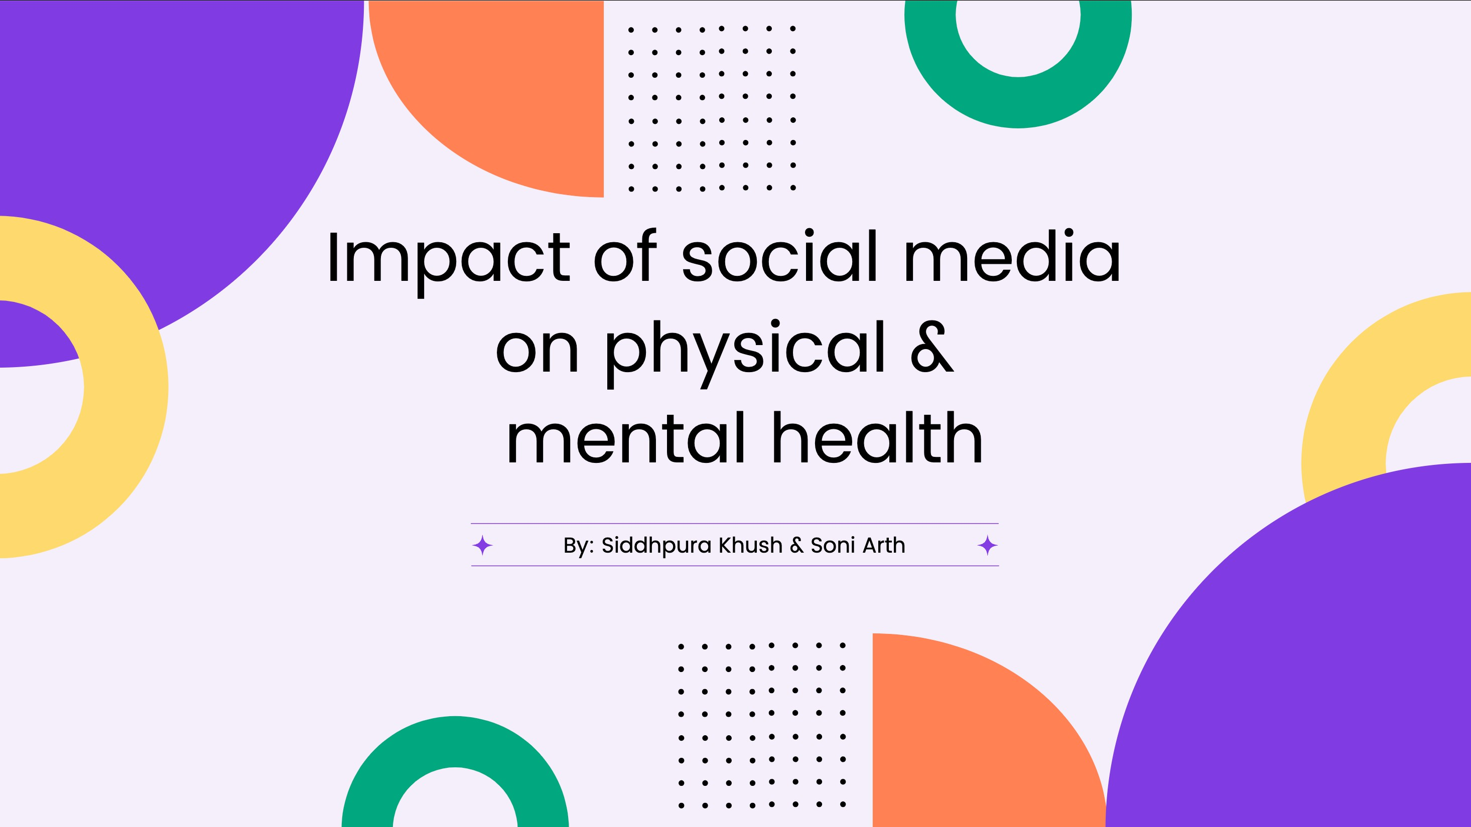



Slide 2
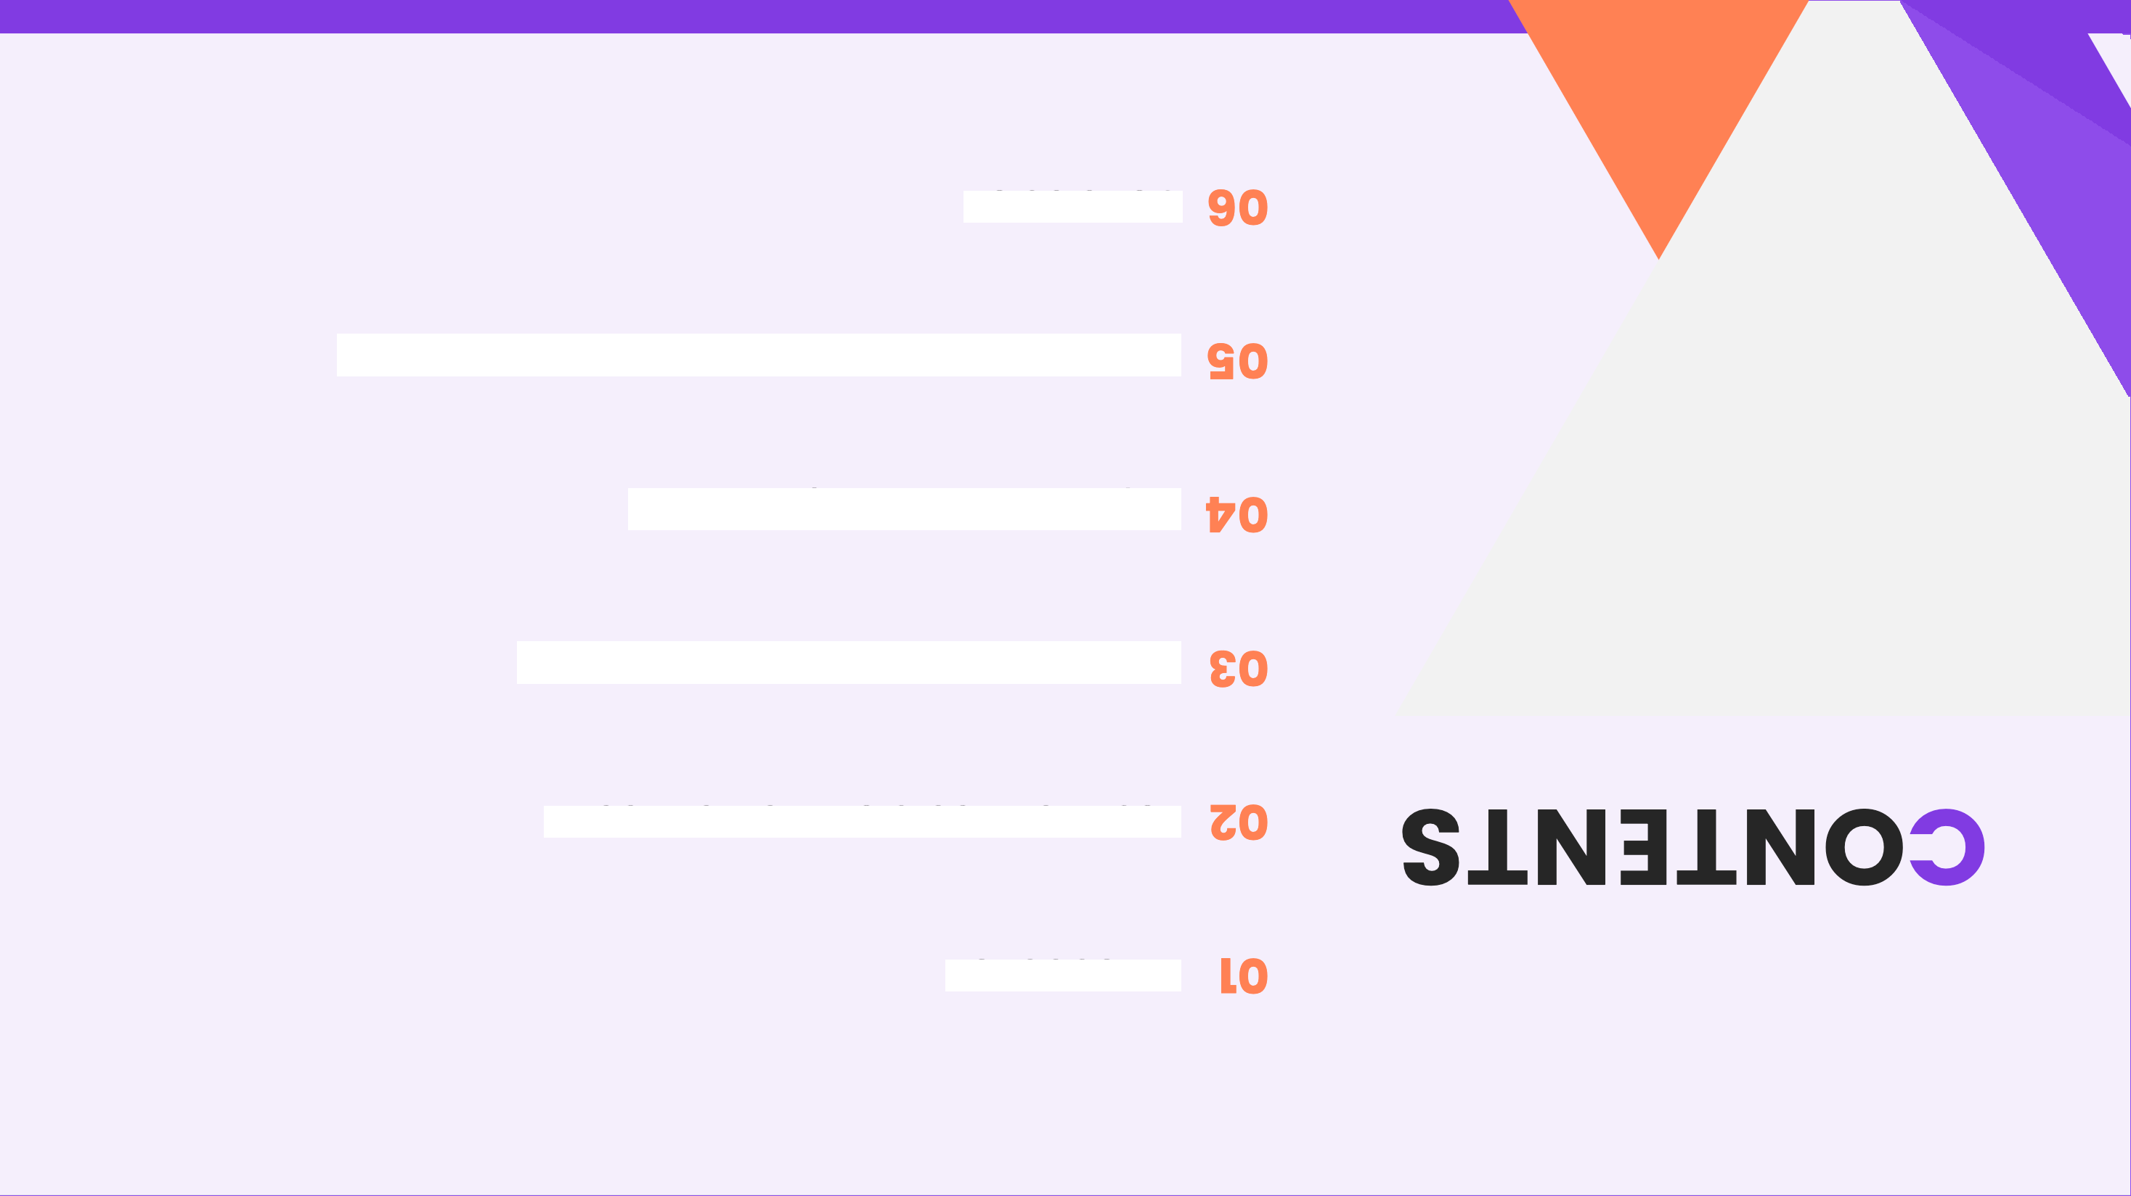
uo¡sni»uog
6ÂOSț§ *h1iOâH JO} Sâțda\o‹ts puo suo¡\mos
suo¡țoc!id\+*I uJiO6HiOCjS/t(Jd
VJIOâH IOțU6|/'\} UO SțC6jjȘ âAjțO@âN
flJiOâH iOțU6ț'\j UO SțC6jjȘ âAjțjSOd
uo¡țcnpo‹țui

Slide 3
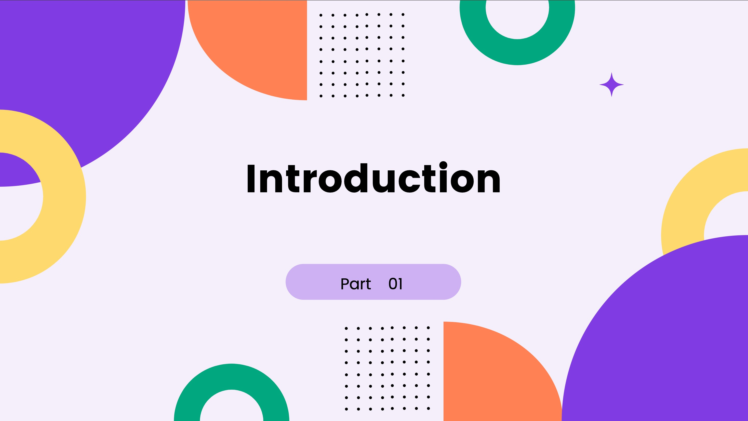

Slide 4
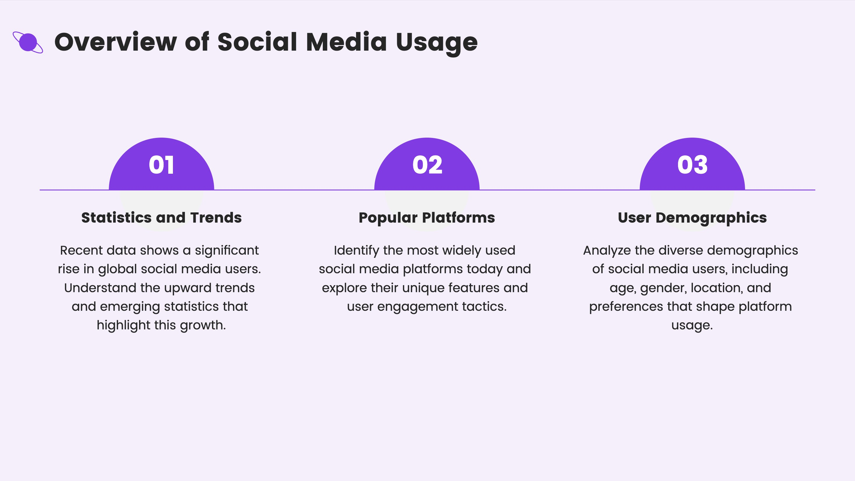

Slide 5

Q, Purpose ond Scope
Research Objectives
Set cleor research objectives to guide the onolysis of sociol medio usage, focusing on key questions ond desired outcomes.
Importance of the Study
Discuss the significonce of the study in understonding sociol medio dynamics and its impoct on communicotion, marketing, ond daily life.
02

Slide 6

Positive E ects on Mentol Heolth

Slide 7


'M, Emotionol Support ond Community Building
Online Support Groups
Online support groups provide o sofe spoce for individuals to shore experiences, receive empothy, and find comoroderie, which helps in reducing feelings of loneliness.
Community Engagement
Engoging with communities, both online ond offline, fosters a sense of belonging ond collective identity, which con significontly enhonce emotionol well- being and resilience.

Slide 8


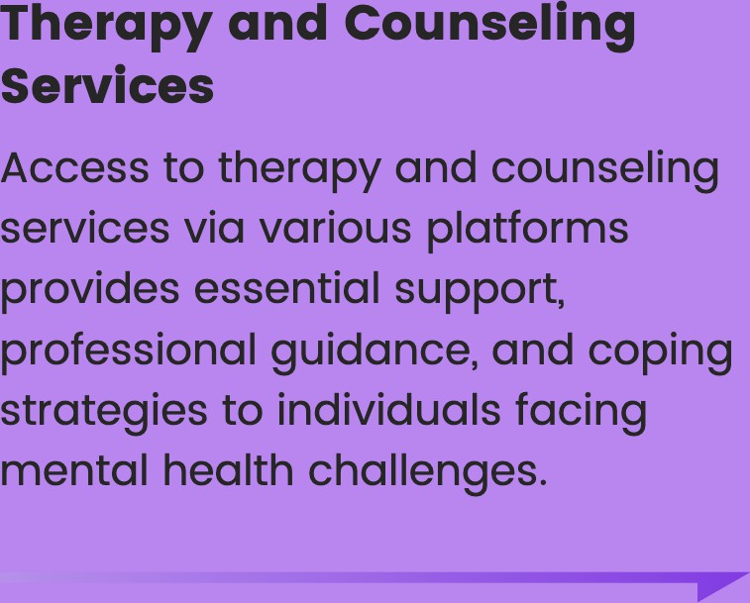


Access
Mental Health Resources
assistance
acute helping
situations
with

Slide 9

Ne otive E ects on Mentol
Heolth

Slide 10






@,Anxiety
Depression
Comparison and Envy
Individuols often compore their lives to others' curoted sociol medio profiles, leoding to feelings of inodequocy ond envy thot con trigger onxiety ond depression.
Cyberbullying
Cyberbullying on sociol media plo0orms con severely impoct mentol heolth, cousing emotionol distress, onxiety, depression, ond in extreme coses, leoding to self- horm or suicidal thoughts.

Slide 11
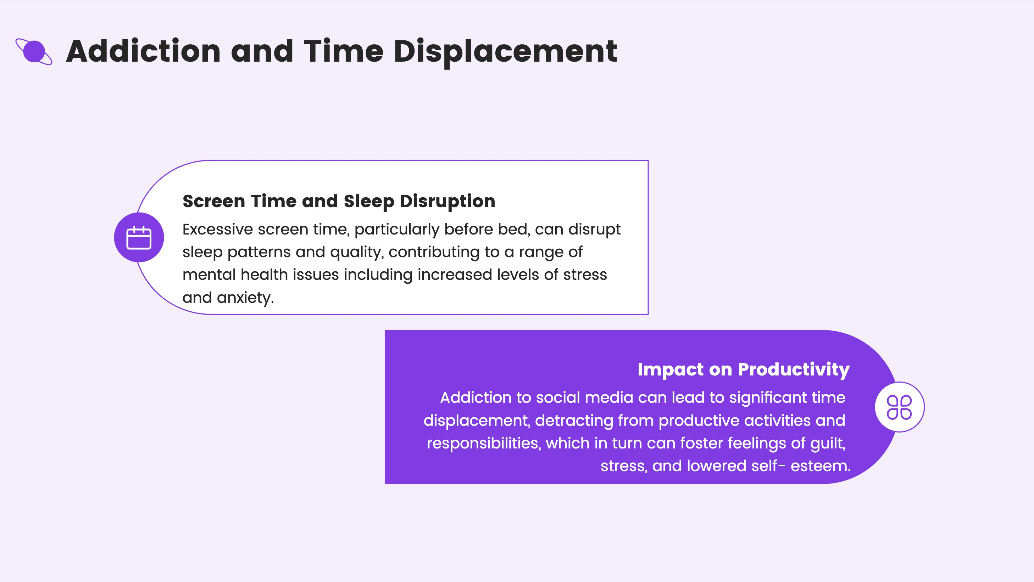

Slide 12
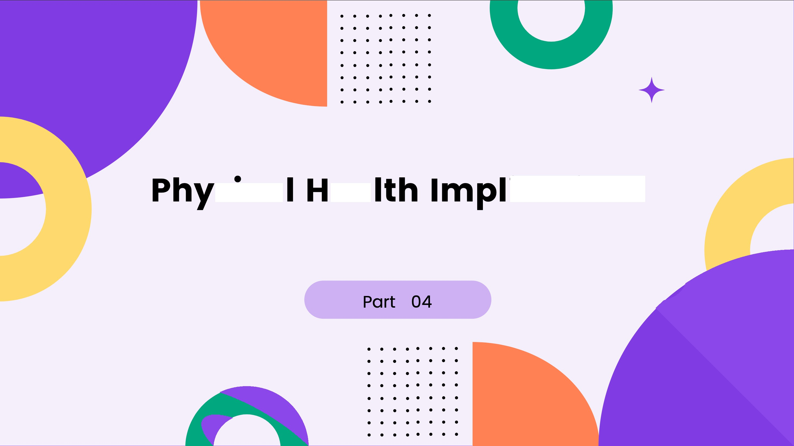
sico eo
icotions

Slide 13
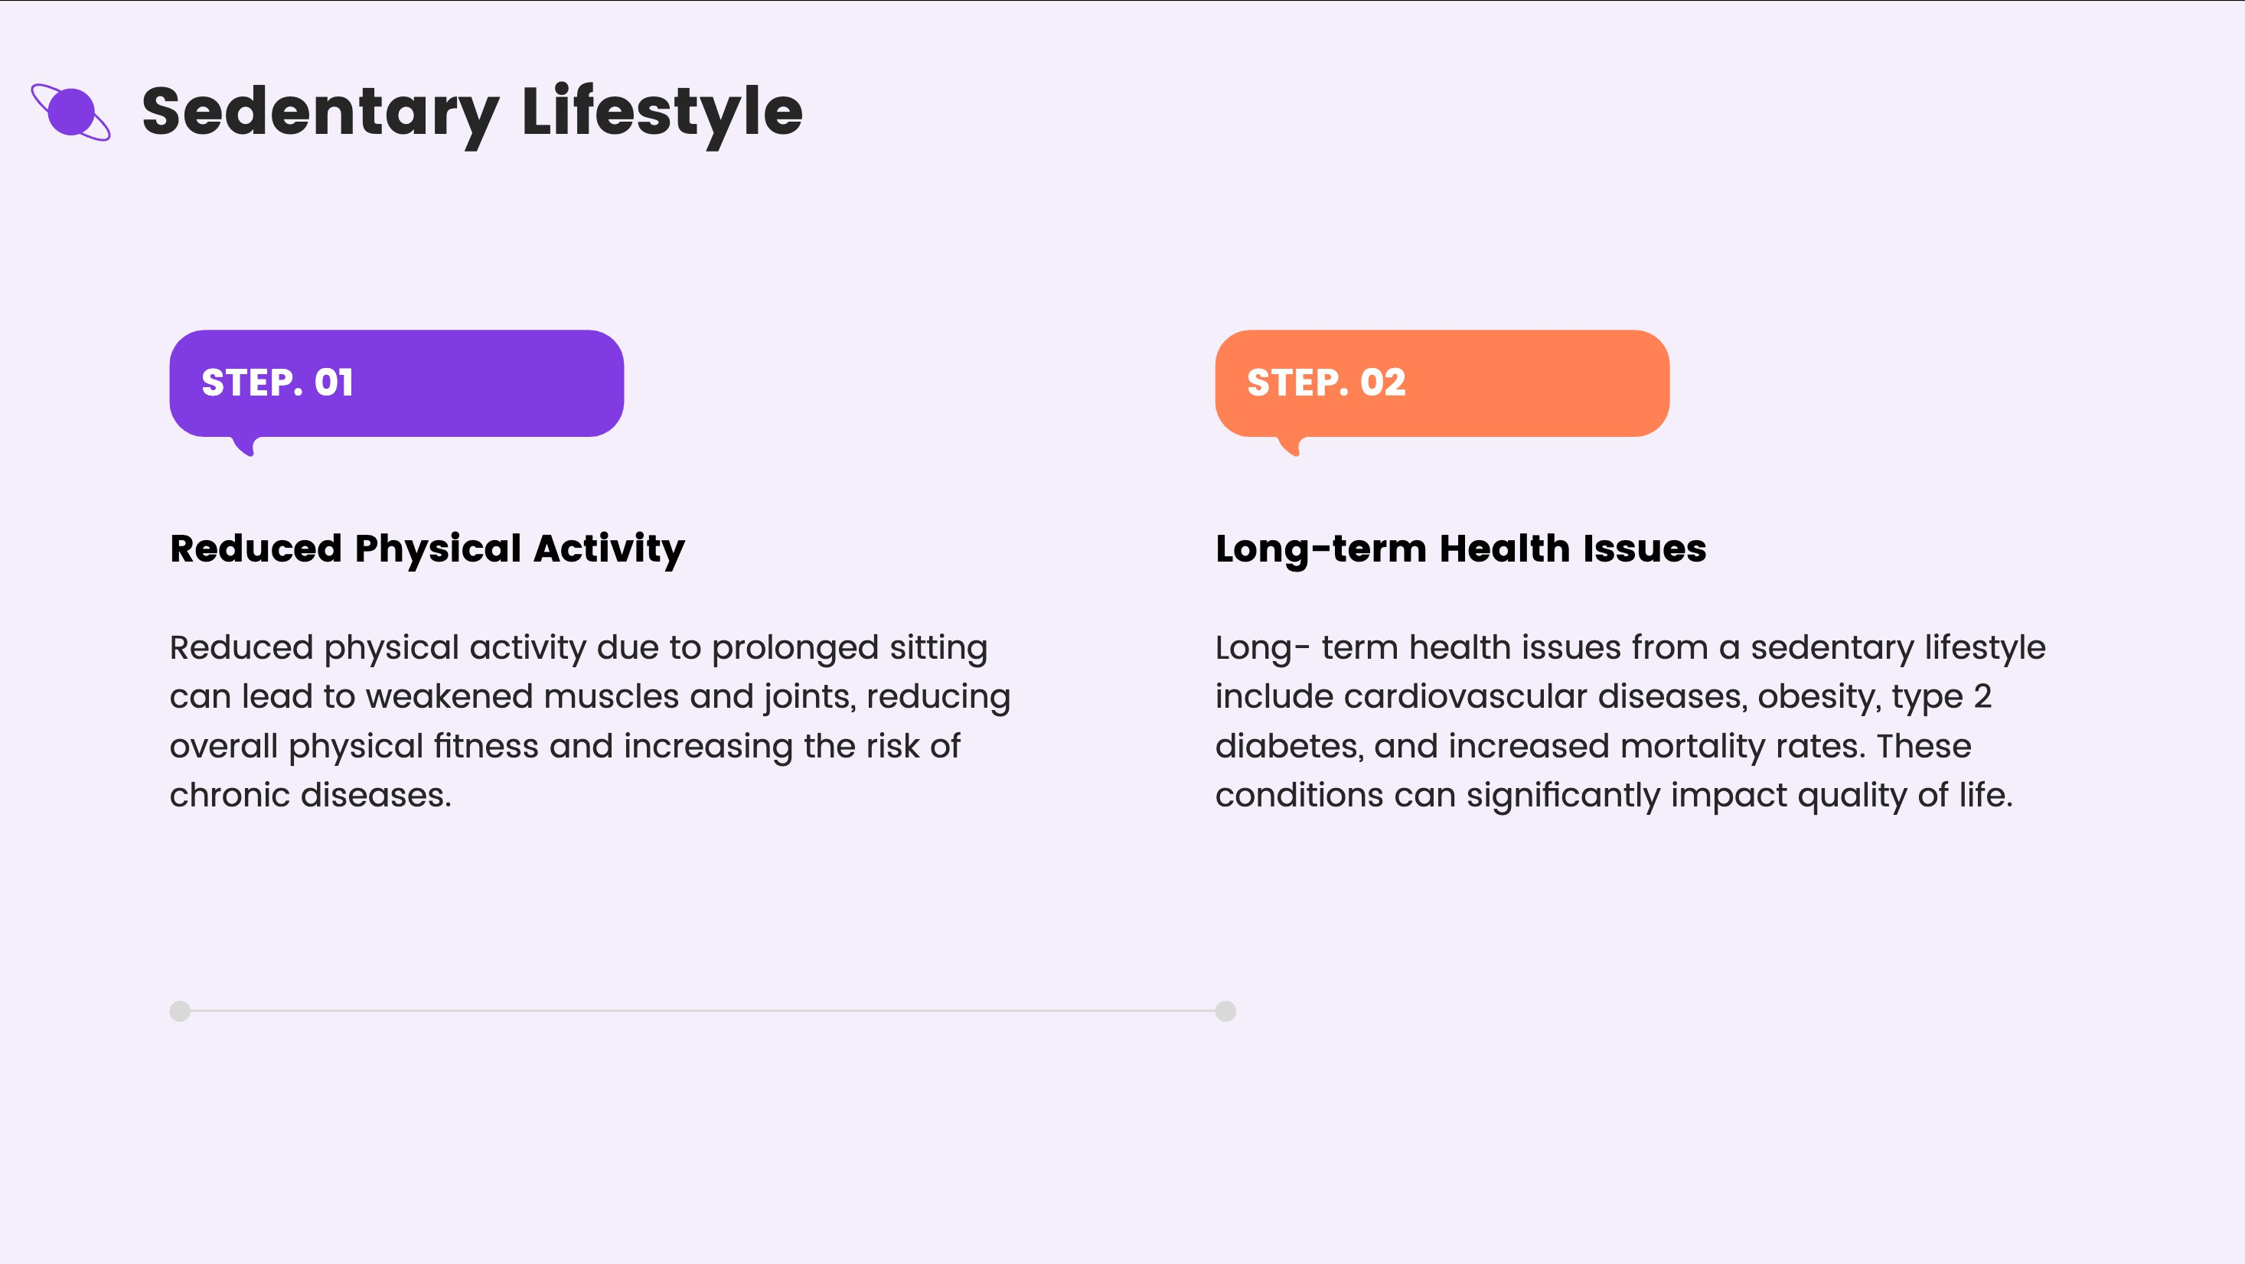

Slide 14

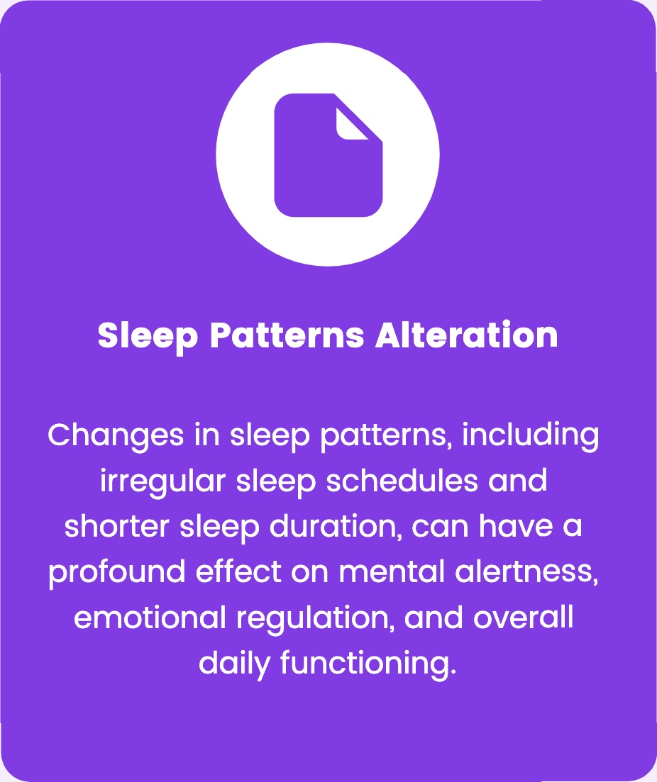
Sleep Disturbonces
Blue Light Exposure
Exposure to blue light from screens disrupts the production of melotonin, creoting difficulties in folling osleep ond reducing the quality of sleep, leoding to overoll fotigue.

Slide 15

Solutions ond Strote ies
Heolth Uso

Slide 16









Digitol Detox
Time Monogement
Scheduled Breaks
Incorporating scheduled breaks con prevent digital fatigue. Encourage frequent pauses in screen usage to enhance productivity and reduce eye strain.
Usage Tools
Utilizing apps thot track and limit screen time con help manage digital consumption. These tools provide insights into usage patterns and encourage balanced habits.
Healthy Online Habits
Developing healthy online habits includes setting boundaries for screen time, prioritizing offline activities, and ensuring digit I activities odd value to one's life.

Slide 17
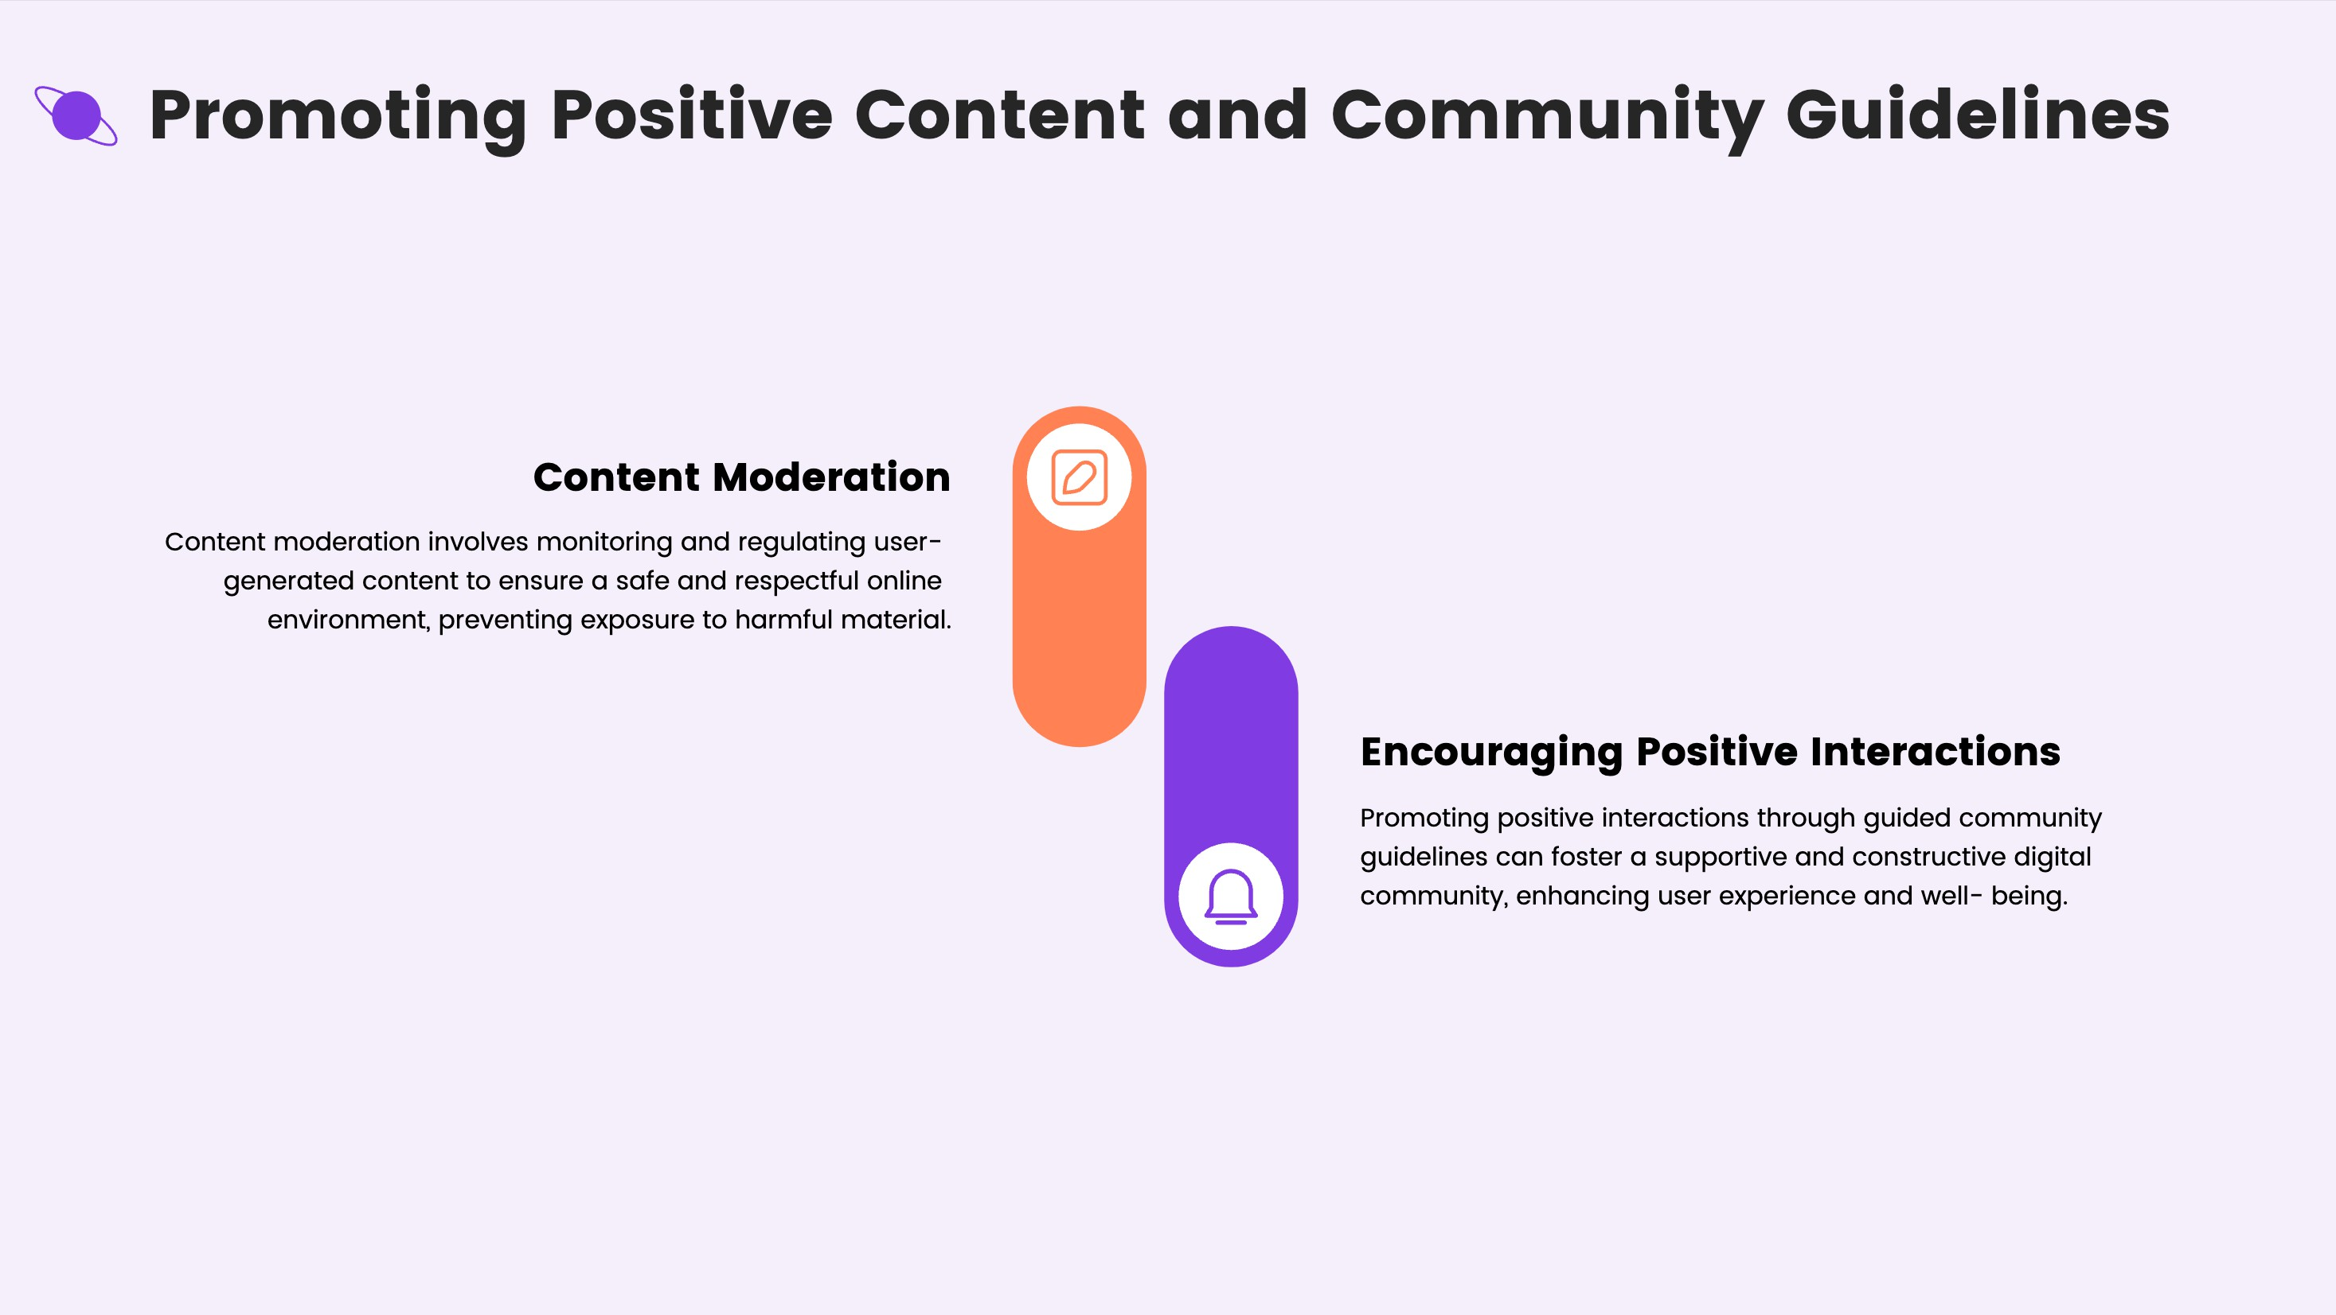

Slide 18
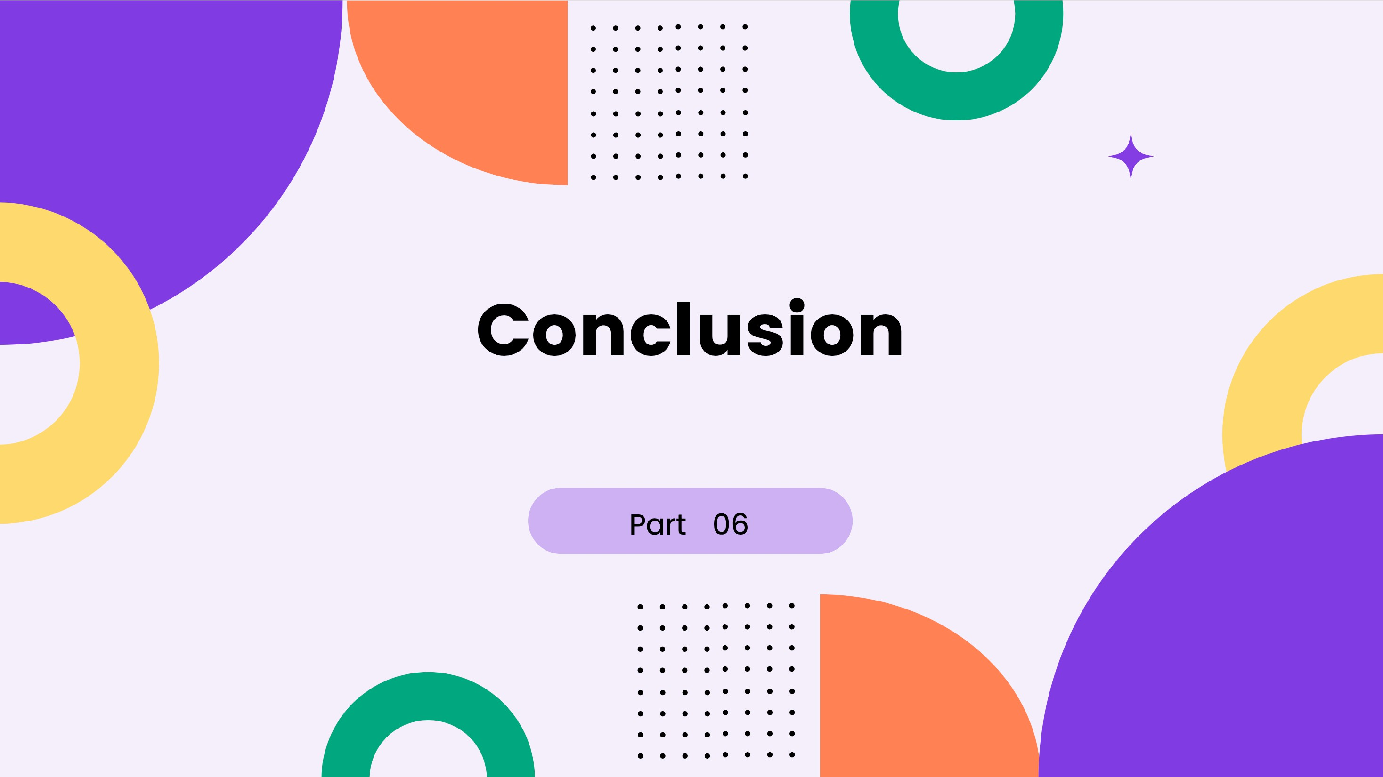

Slide 19
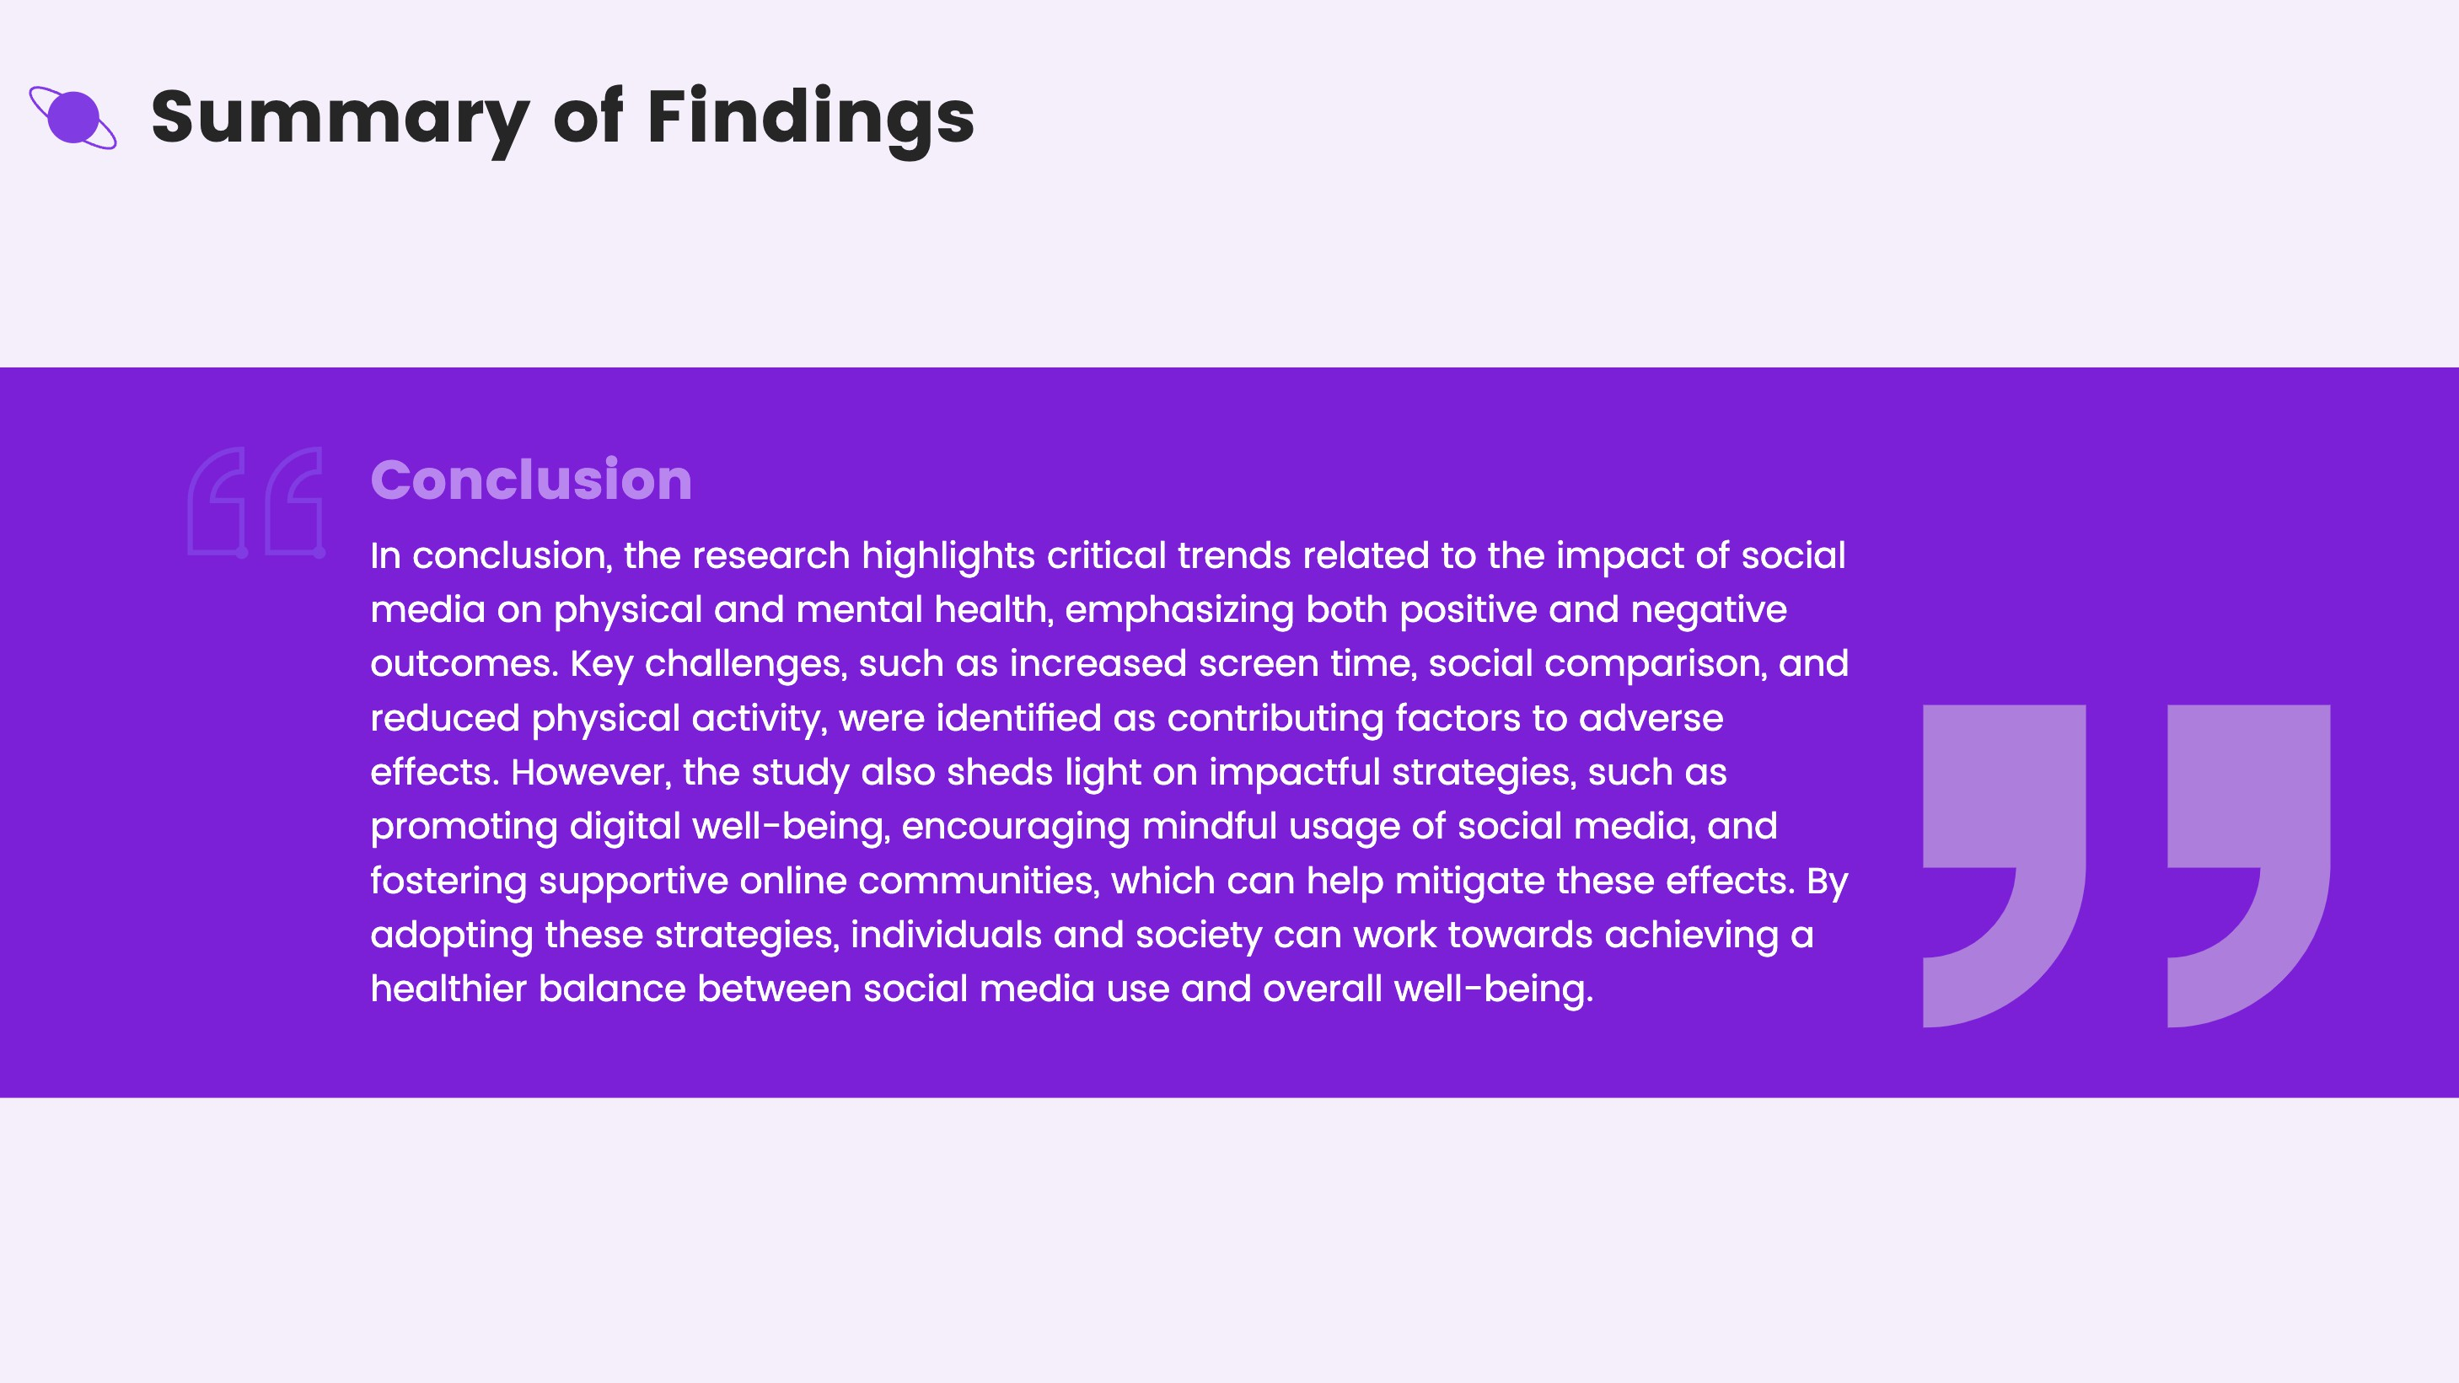

Slide 20

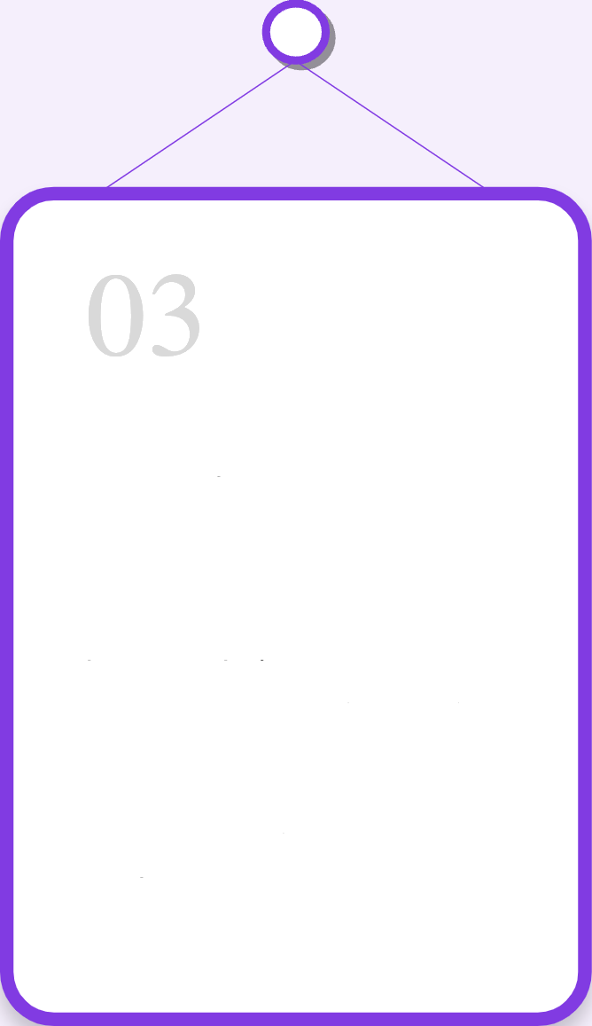

Recommendotions
For Users
For Platforms
For Policymakers
Users should odopt best proctices to enhonce personol doto security ond octively porticipote in plotform communities to moximize benefits ond minimize risks.
Plo0orms ore encouroged to prioritize user ex erience enhoncements, implement innovative security meosures, and continuously adopt to user needs and feedback for long- term success.
Policymokers should develop robust regulations to protect user doto, promote foir platform practices, and ensure digitol inclusivity ocross diverse demographics for holistic growth.

Slide 21
